Slide 1

WATERFALL MODEL for PASSWORD GENERATOR
ID: 202438404
AKHMEDOV YUSUFJON MAKHAMMAD UGLI

Slide 2
REQUIREMENT Analysis
Password should be created including
these components:
Uppercase
Lowercase
Digits
Symbols
Generate secure, random passwords with configurable character types.
Each character type must be configurable within the range of 1 to 4
Input validation is required to enforce constraints.

Slide 3
Design of system
Python >=3.10 programming language
Pydantic Library to handle data validation.
PasswordGenerator Class.

Slide 4
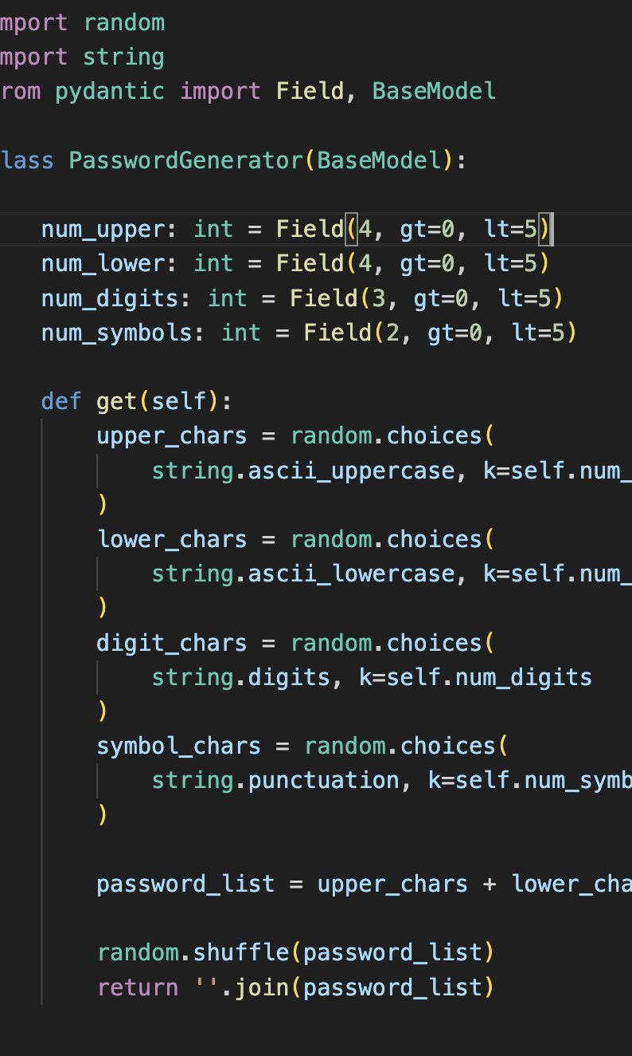
Implementation/coding

Slide 5
TESTING
Basic Unittest
Checking password length on output
Character count testing
Error case testing

Slide 6
Deployment
Uploading project to GitHub to public repo
https://github.com/yusufjonc07/CourseAssignments/tree/ddf5041b054b572268af880454b5e69174b1ee04/software-engineering/4.%20Testing%2C%20Rad%20Model/PasswordGenerator

Slide 7
MAINTENANCE
Create RESTAPI
Accessible from browser.
Accessible for any application.

